Slide 1


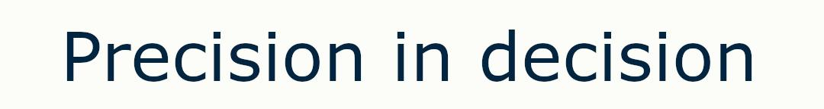
Unai Laskurain - Xabat Maortua - Andoni Usandizaga - Julen Gabilondo - Peru Ramos
Arrasate, 23Th of November of 2023

Slide 2

INDEX
PROBLEM ANALYSIS
SDG GOALS
MARKET
CONCLUSION

Slide 3
1
Problem analysis

Slide 4
Description of the problem
The 98% of the people that invest in the stock market losses their money
A lot of factors affect stock market:
  A large number of them are helpful in order to predict
  Humans can’t process them efficiently before the data changes
There is no any tool for accurate and adaptive predictions
Problem analysis

Slide 5
Objectives
Develop a robust AI model for stock market predictions:
  Obtain a real minimum accuracy of around 60%
Minimize investment risks through comprehensive risk assessment
Help users understand the stock market
Elaborate a recommendation system for the user with 80% of accuracy
Problem analysis

Slide 6
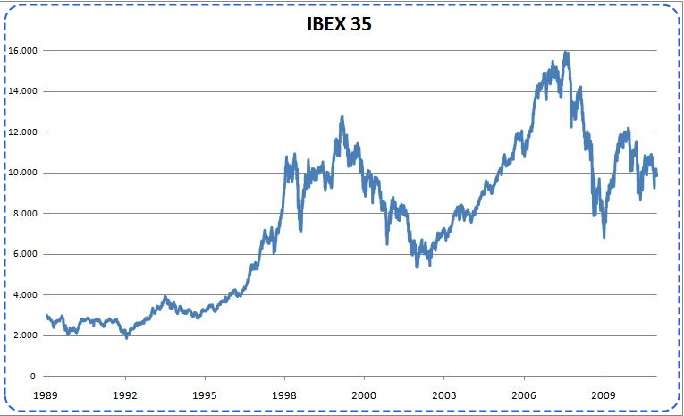
Functionalities of the product
Make accurate predictions of the future:
  Analyze historical data
  Analyze external factors
  Get and analyze data in real time
Visualize analyzed data
Recommendation system for the user
Problem analysis

Slide 7

2
SDG GOALS

Slide 8





SDG alignment
SDG Goals

Slide 9
3
MARKET

Slide 10


Customers
Investors and Traders
Financial Institutions
Corporate Entities
Academic and Research Institutions
Market

Slide 11
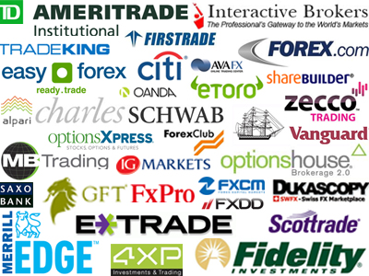
Competitors analysis
Financial institutions
  Laboral Kutxa, BBVA, Santander…
Brokers
  Etoro, XTB, ´Plus500…
Other particulars of this sector
  Neptune.ai, TENVIZ…
Market

Slide 12
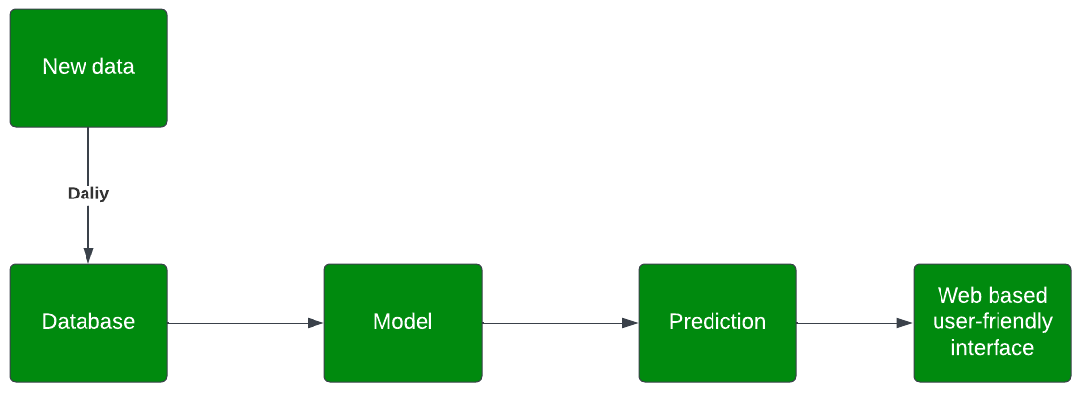
Solution’s added value
Continuous learning and adaptation + real-time updates
Incorporation of diverse data sources
User-friendly interface and accessibility
Explainability and transparency
Market

Slide 13
4
CONCLUSION

Slide 14
Conclusion
AI generated stock market predictions
Intelligence and precision through different type of factors
  Historical factors
  External factors
  Real time data
Minimize risks, maximize profits
Conclusion

Slide 15
Thanks!
Any Questions?
tarde.hunter.ai@gmail.com
+34 634 44 02 94

